Slide 1
Department of Electronics and Communication Engineering Academic Year: 2024 – 2025 (Even Semester) Register Number :927624BEC017 Name :K.ARUN Year : I Semester : II Section : A Date₁ :11.06.2025
EGB1122 – PYTHON PROGRAMMING END SEMESTER PROJECT REVIEW

Slide 2
SCHOOL MANAGEMENT SYSTEM
Title of the Project

Slide 3
The School Management System is a Python application designed to automate and simplify administrative tasks in educational institutions. It utilizes Python's Tkinter library for the graphical user interface (GUI) and SQLite fordatabase management. Key features include managing student recordtracking attendance, handling fee payments, and maintaining library records. The system aims to reduce manual paperwork, minimize errors, and enhance operational efficiency.
Abstract

Slide 4
4 EGB1122 – PYTHON PROGRAMMING –PROJECT REVIEW 1
Abstract with CO/PO Mapping
Abstract | CO | POs | PSO
The School Management System is a Python application designed to automate and simplify administrative tasks in educational institutions. It utilizes Python's Tkinter library for the graphical user interface (GUI) and SQLite for database management. Key features include managing student records, tracking attendance, handling fee payments, and maintaining library records. The system aims to reduce manual paperwork, minimize errors, and enhance operational efficiency. | C01 C02 CO3 C04 | PO1 PO2 PO3 PO4 PO5 PO6 PO7 | PSO1 PSO2

Slide 5
、 The School Management System in Python is a software application developed to streamline and automate the daily administrative and academic tasks in educational institutions. This system is designed using Python, one of the most popular and versatile programming languages, which makes it both efficient and scalable.The goal of this project is to create a user-friendly platform that allows school administrators, teachers, and staff to manage key information such as student records, class schedules, attendance, exam results, and fee management. By digitizing these processes, the system reduces paperwork, minimizes human errors, and enhances the overall efficiency of school operations.
Introduction

Slide 6
、 Variables and Data Types 、 Control Structures 、 Functions 、 Object-Oriented Programming (OOP) 、 File Handling 、 Modules and Packages 、 Database Connectivity
Python Programming - Concepts Used

Slide 7



Output / Response to User
Proposed Architecture
User Input
Presentation Layer (CLI/ GUI)
Application Layer (Logic) (e.g., Manage Students, Attendance, Grades)
Data Layer (Files/ Database)

Slide 8
• Proposed Architecture - Description
• User Login
• | Dashboard / Home
• | Student Management
• | Teacher Management
• | Teacher Management
• | Attendance Module
• | Fee Management

Slide 9
、 Student Management Module 、 Teacher Management Module 、 Attendance Module 、 Examination & Result Module 、 Fee Management Module
9 EGB1122 – PYTHON PROGRAMMING –PROJECT REVIEW 1
List of Modules

Slide 10
 | 1. Student Management Module Manages student records including adding, editing, viewing, and deleting student information. 2.Teacher Management Module Handles teacher profiles, subject assignments, and updates to their teaching details. 3.Attendance Module Tracks daily attendance of students and generates attendance reports for analysis. 4. Examination & Result Module Conducts exam scheduling, records marks, and generates report cards or result summaries. 5. Fee Management Module Manages student fee payments, tracks due amounts, and generates invoices or receipts.
Description of Modules

Slide 11
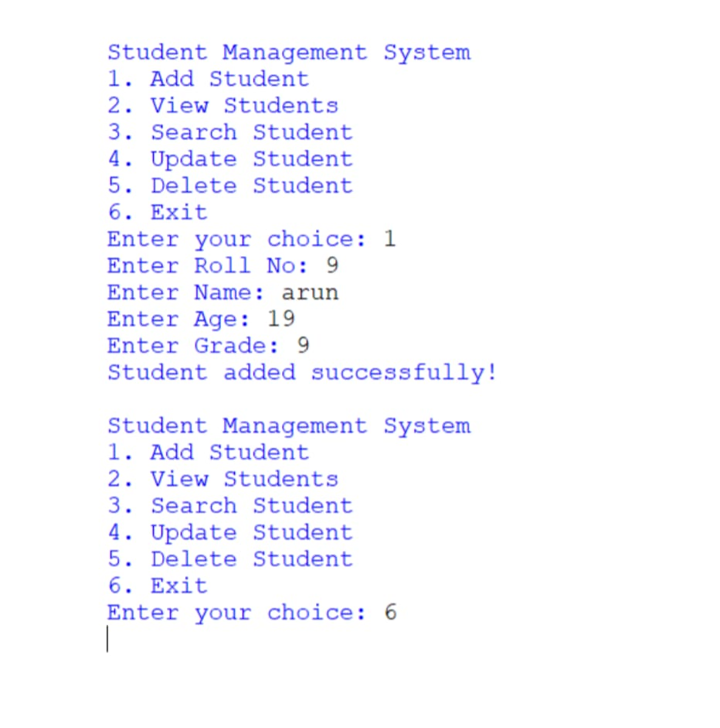
11 EGB1122 – PYTHON PROGRAMMING –PROJECT REVIEW 1
Result

Slide 12
The School Management System developed in Python provides an efficient way to manage school operations digitally.With modules for student and teacher management, attendance tracking, examination and result processing, and fee management, the system simplifies administrative tasks and reduces manual effort.
Conclusion

Slide 13
13 EGB1122 – PYTHON PROGRAMMING –PROJECT REVIEW 1
Thank You

